Slide 1
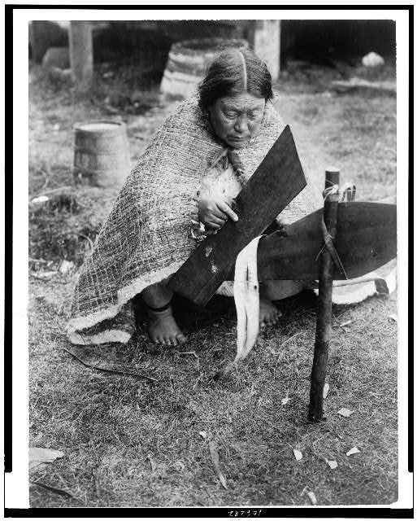
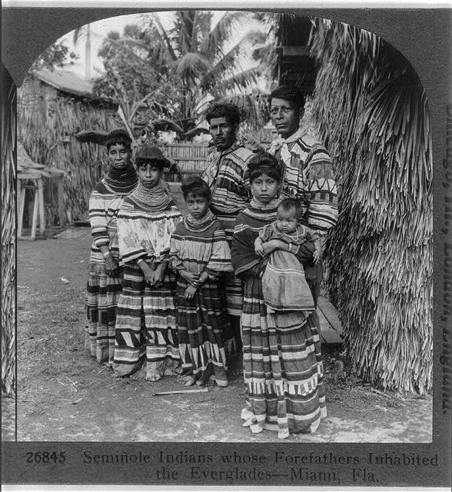
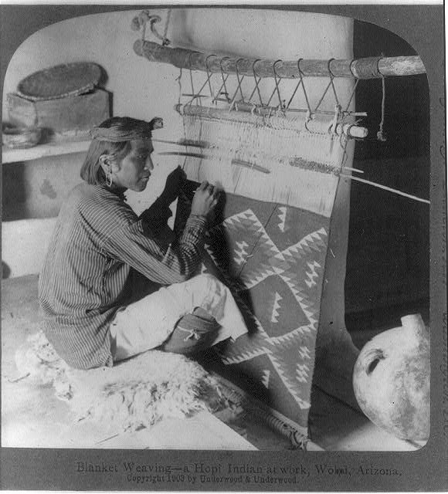
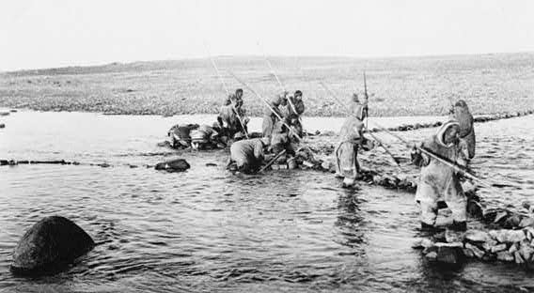
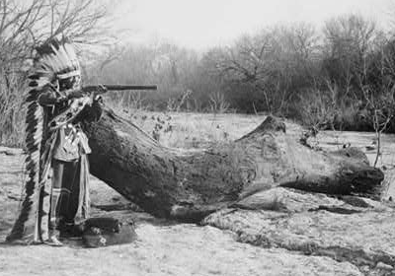
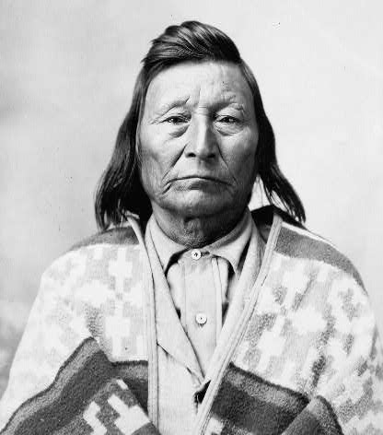

Explore the Native American Nations
The Native American Nations of North America cultivated the natural resources around them to provide food and housing materials.
They adapted to their environments, and their culture grew from those adaptations.
Just as the climate and geography of North America varies tremendously, so too did the cultural groups that scattered across our great continent.
Click to learn more about them.
Seminole
Pawnee
Innuit
Nez Perce
Kwakiutl
Hopi

Slide 2
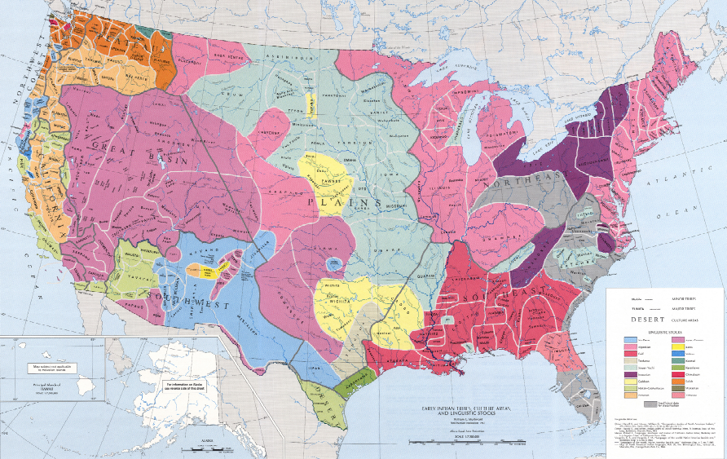
Click on an area of the map to learn about the Native peoples who lived there. Use your field book to record the important details you find.
Click the map icon in the top left corner to return to this page at any time.
* USGS Map

Slide 3
Hopi of the Southwest
The Hopi:
Lived in the low, flat desert and high plateaus of the dry Southwest
Grew beans, squash, and maize (corn )
Built large “pueblo” homes with many rooms
Were the first in the world to fire clay pottery
Photograph courtesy The Library of Congress
Greetings, Historian!
Check out the Hopi to discover ways the Hopi used the natural resources around them.
Use your field book to guide your search and record your answers.

Slide 4
Kwakiutl of the Northwest
The Kwakiutl:
Lived near the Pacific coast.
Built large homes from cedar trees.
Caught a surplus of salmon, which they dried and ate year-round
Photograph courtesy The Library of Congress
Greetings, Historian!
Check out the Kwakiutl Indian Band to discover ways the Kwakiutl used the natural resources around them.
Use your field book to guide your search and record your answers.

Slide 5
Pawnee of the Great Plains
The Pawnee:
Grew corn, squash, and beans half of the year
Hunted buffalo during the other half of the year
Built permanent lodges using bark, earth, and grass
Photograph courtesy The Library of Congress
Greetings, Historian!
Check out the Smithsonian National Museum of American History to learn more about the Pawnees by analyzing their artwork.
Use your field book to guide your search and record your answers.

Slide 6
Nez Perce of the Northwest
The Nez Perce:
Lived in the plateaus and the valleys of what is now known as north central Idaho, Montana, northeastern Oregon, and southeastern Washington, an area of about seventeen million acres.
Traveled and fished along their many rivers every season.
Migrated to hunt and gather during summer and fall.
Photograph courtesy The Library of Congress
Greetings, Historian!
Check out the Nez Perce National Historical Park to discover ways the Nez Perce used the natural resources around them.
Use your field book to guide your search and record your answers.

Slide 7
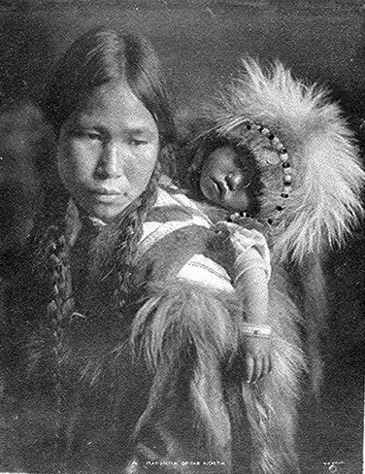
The Inuit of Alaska and Northwest Canada
Inuit:
Lived in the extreme arctic climate of Northwest Canada
Traveled and fished along the ocean and seashore every season.
Built “igloo” homes out of ice and snow
Wore thick clothing made from caribou (reindeer) and seal hides
Photograph courtesy The National Archives
Greetings, Historian!
Check out the above links to discover ways the Inuit used the natural resources around them.
Use your field book to guide your search and record your answers.

Slide 8
Seminoles of the Southeast
The Seminoles:
Lived in what is now know as Florida
Wore light clothing made of grass and thin cloth
Built roundhouses made of wooden poles covered with clay and bark, sometimes without walls
Photograph courtesy The Library of Congress
Greetings, Historian!
Check out the Seminole Tribe of Florida to discover ways the Seminoles used the natural resources around them.
Use your field book to guide your search and record your answers.

